Slide 1
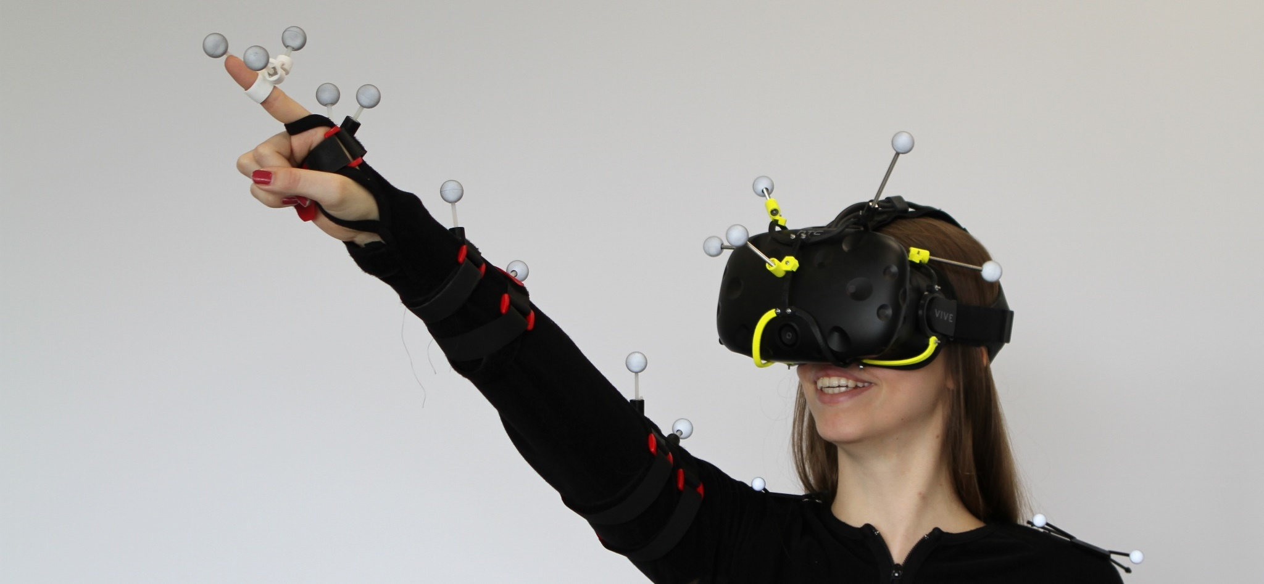
Basics of Fitts’ Law
Schwind, V., Mayer, S., Comeau-Vermeersch, A., Schweigert, R., & Henze, N. (2018). Up to the Finger Tip: The Effect of Avatars on Mid-Air Pointing Accuracy in Virtual Reality. CHIPLAY.
Notes:
https://pixabay.com/de/photos/lego-legoland-bauen-spielen-2383096/
https://www.pexels.com/photo/woman-wearing-pink-overcoat-and-black-inner-top-2043590/
https://www.pexels.com/photo/earth-desert-dry-hot-60013/
https://www.pexels.com/photo/architect-architecture-artist-blur-268362/

Slide 2
Learning Goals
Now the purpose of Fitts’ Law
Can determine the index of difficulty for pointing tasks
Be able to determine the device-specific constants
Basics of Fitts’ Law

Slide 3
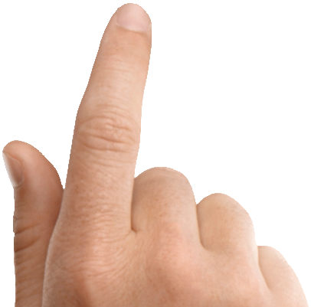
Pointing
Basics of Fitts’ Law

Slide 4
Pointing depends on distance and width
distance
width
Basics of Fitts’ Law

Slide 5
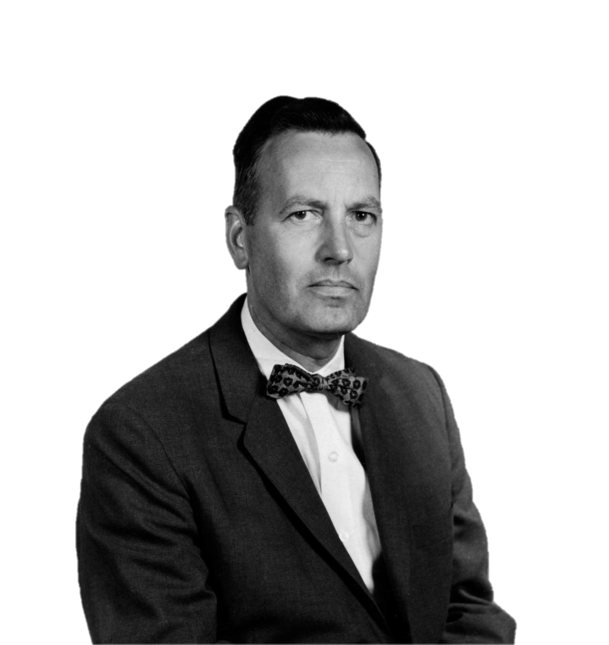
Paul Fitts
From: U-M Library Digital Collections. Bentley Image Bank, Bentley Historical Library. Accessed: March 27, 2020. CC BY 4.0
Basics of Fitts’ Law

Slide 6
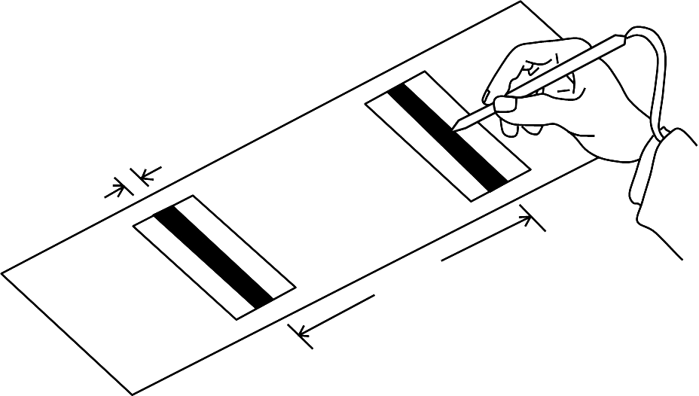
Paul Fitts’ pointing task
From: Fitts, P. M. (1954). The information capacity of the human motor system in controlling the amplitude of movement. Journal of experimental psychology, 47(6), 381.
width
distance
Basics of Fitts’ Law

Slide 7
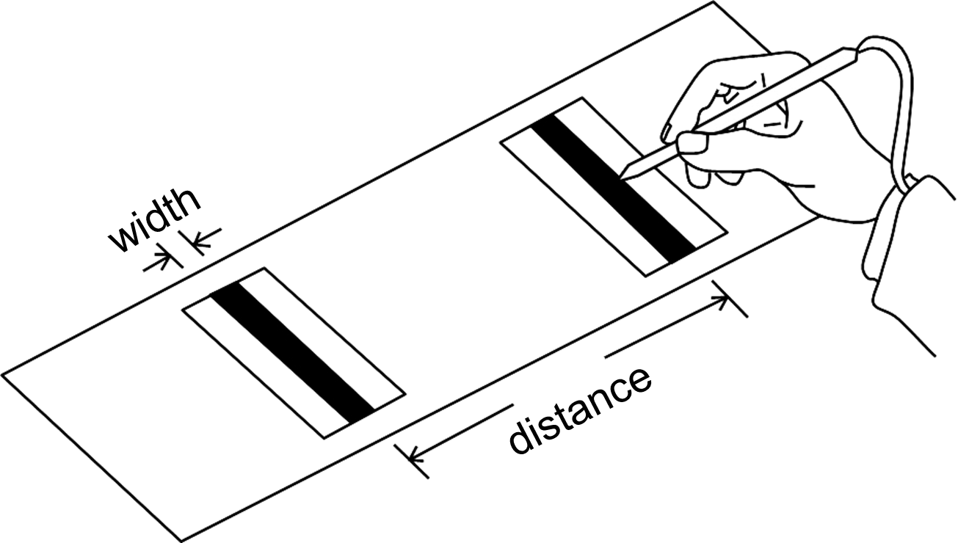
From: Fitts, P. M. (1954). The information capacity of the human motor system in controlling the amplitude of movement. Journal of experimental psychology, 47(6), 381.
Basics of Fitts’ Law

Slide 8
Varying distance and width
From: Fitts, P. M. (1954). The information capacity of the human motor system in controlling the amplitude of movement. Journal of experimental psychology, 47(6), 381.
Four distances:
2, 4, 8, 16 inch
Four widths:
0.25, 0.5, 1.0, 2.0 inch
Basics of Fitts’ Law

Slide 9
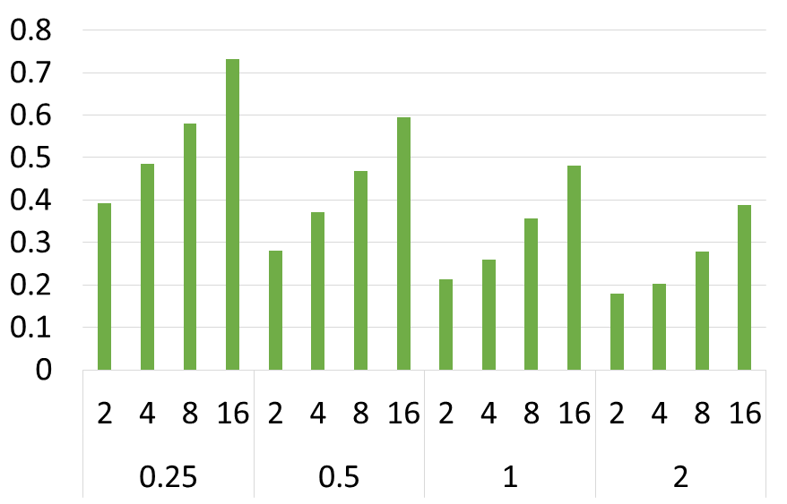
Paul Fitts’ empirical results
From: Fitts, P. M. (1954). The information capacity of the human motor system in controlling the amplitude of movement. Journal of experimental psychology, 47(6), 381.
movement time in seconds
distance & width
Basics of Fitts’ Law

Slide 10
Change in movement time
From: Fitts, P. M. (1954). The information capacity of the human motor system in controlling the amplitude of movement. Journal of experimental psychology, 47(6), 381.
movement time in seconds
distance & width
Basics of Fitts’ Law

Slide 11
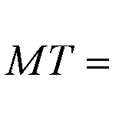
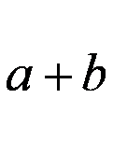
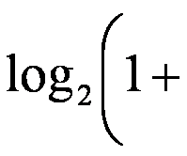
Definition of Fitts’ Law
The movement time (MT) to select a target is a function of the target’s width (W) and distance (D). It depends on the input device.
MT: movement time
a & b: input device-dependent constants
D: distance to the target
W: width of the target
W
D
start
target
Basics of Fitts’ Law

Slide 12
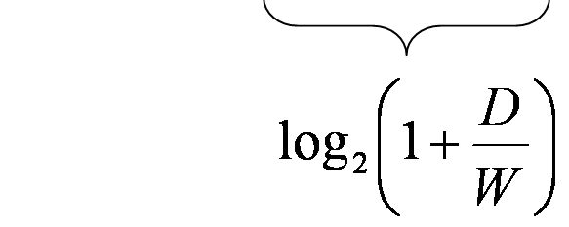
Definition of the index of difficulty
Index of Difficulty, ID =
MT = a + b ·ID
ID how difficult a task is independent from the input device
Units:
a is measured in seconds
b is measured in seconds per bit
Index of Difficulty (ID) is described in bits
Basics of Fitts’ Law

Slide 13
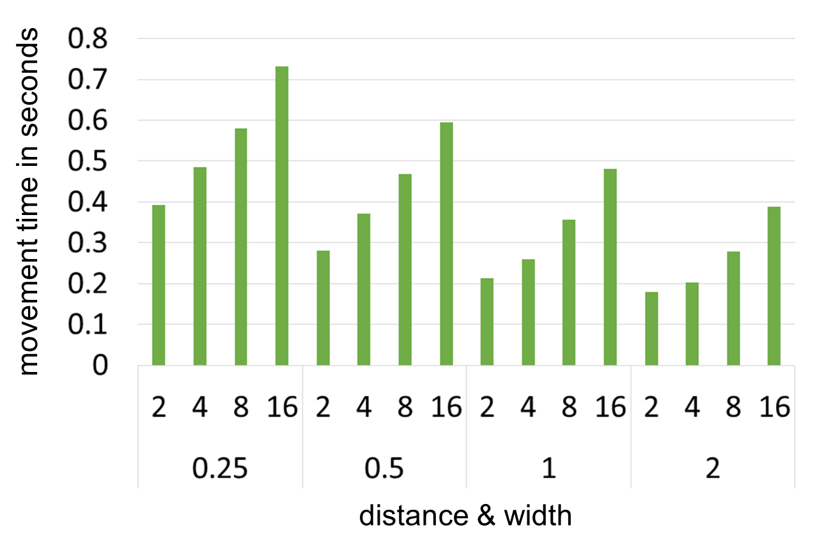
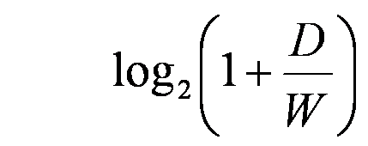
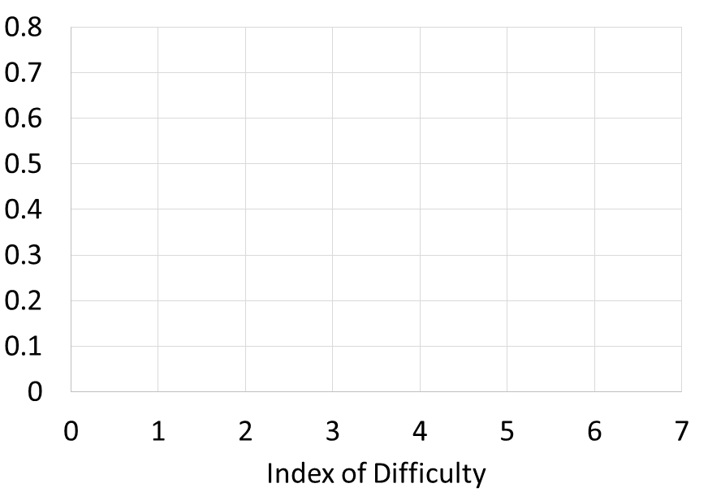
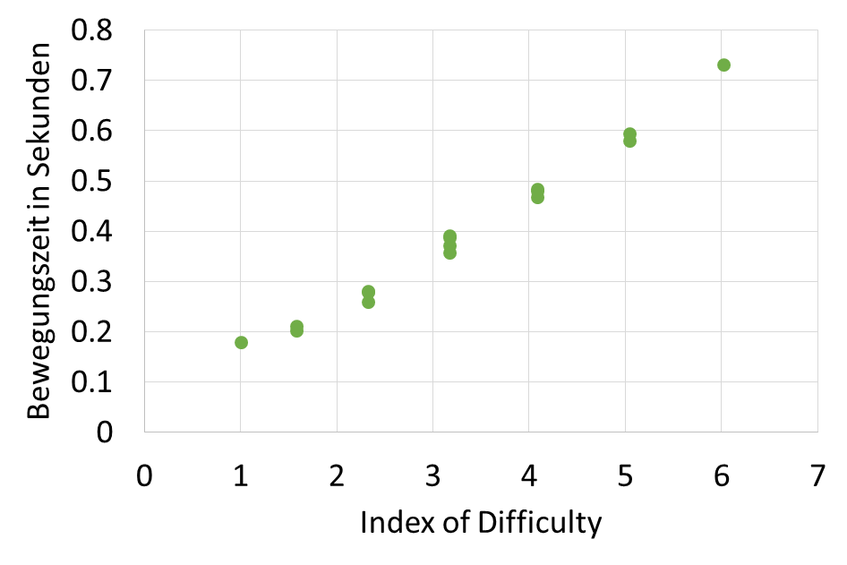
ID Examples
ID =
D=2, W=2
ID=log₂(1+1)=1
D=16, W=0.25
ID=log₂(1+64)=6.02
Basics of Fitts’ Law

Slide 14
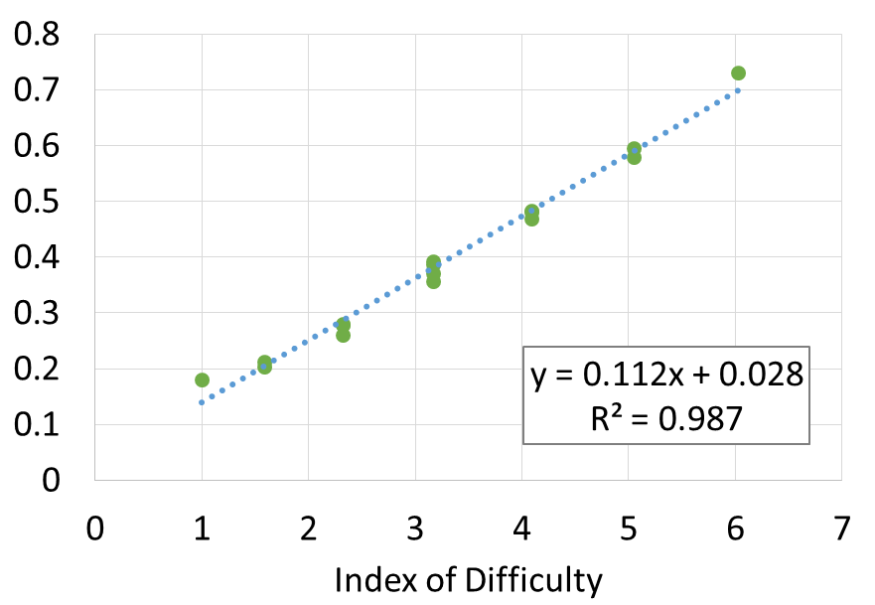
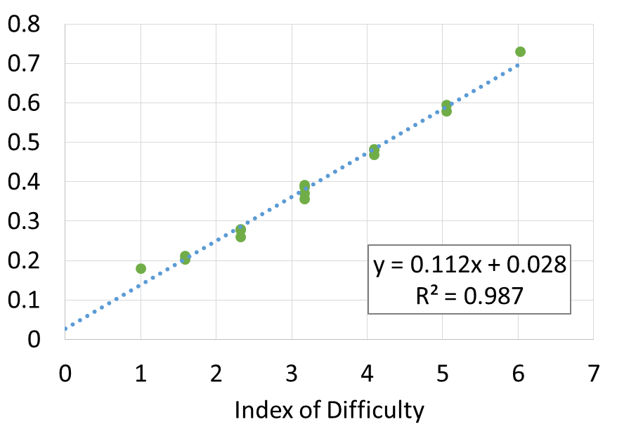
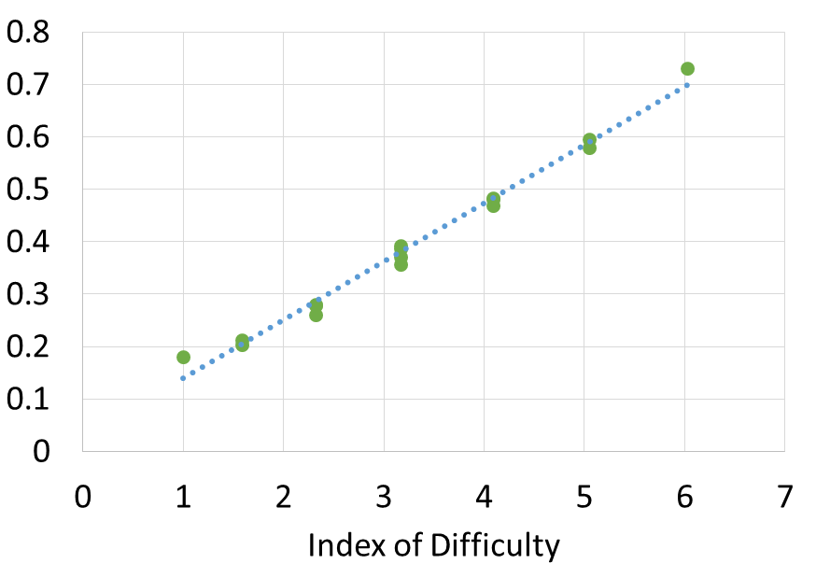
Determining a and b
a=0.028s
b=0.112bit/s
ID =
Basics of Fitts’ Law

Slide 15
Predicting the movement time
a=0.028s
b=0.112s/bit
How long does it take to select a target that is 21 inch away and 3 inch wide?
MT = 0.028+0.112*log₂(1+7)
= 0.028+0.112*log₂(8)
= 0.028+0.112*3
= 0.364ms
Basics of Fitts’ Law

Slide 16
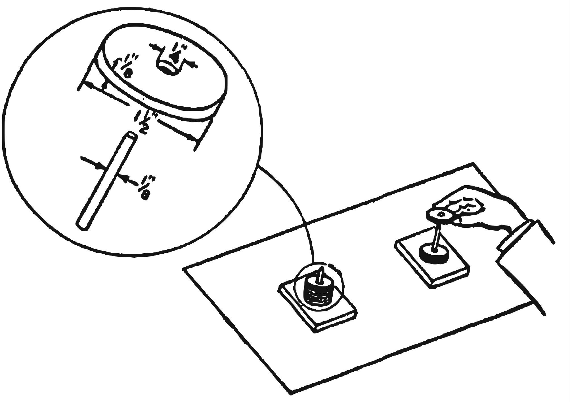
Determine a and b for another task
From: Fitts, P. M. (1954). The information capacity of the human motor system in controlling the amplitude of movement. Journal of experimental psychology, 47(6), 381.
width | distance | MT
0.0625 | 4 | 0.697
0.0625 | 8 | 0.771
0.0625 | 16 | 0.896
0.0625 | 32 | 1.096
0.125 | 4 | 0.649
0.125 | 8 | 0.734
0.125 | 16 | 0.844
0.125 | 32 | 1.028
0.25 | 4 | 0.607
0.25 | 8 | 0.672
0.25 | 16 | 0.771
0.25 | 32 | 0.975
0.5 | 4 | 0.535
0.5 | 8 | 0.623
0.5 | 16 | 0.724
0.5 | 32 | 0.902
What are a and b for this task?
Basics of Fitts’ Law

Slide 17
License
This file is licensed under the Creative Commons Attribution-Share Alike 4.0 (CC BY-SA) license:
https://creativecommons.org/licenses/by-sa/4.0
Attribution: Niels Henze
For more content see: https://hci-lecture.de

Slide 18
License
This file is licensed under the Creative Commons Attribution-Share Alike 4.0 (CC BY-SA) license:
https://creativecommons.org/licenses/by-sa/4.0
Attribution: Niels Henze
For more content see: https://hci-lecture.de

